Slide 1
Biodiversity of Dragonfly Dashboard
Date: 25th Oct. 2024
Presented by
Bigyen Rasaily
Std of Data Science and Data Analytics
Desuung Skilling Program
Guided by
Supriya Jadhav
Tutor
Senior Data Scientist

Slide 2
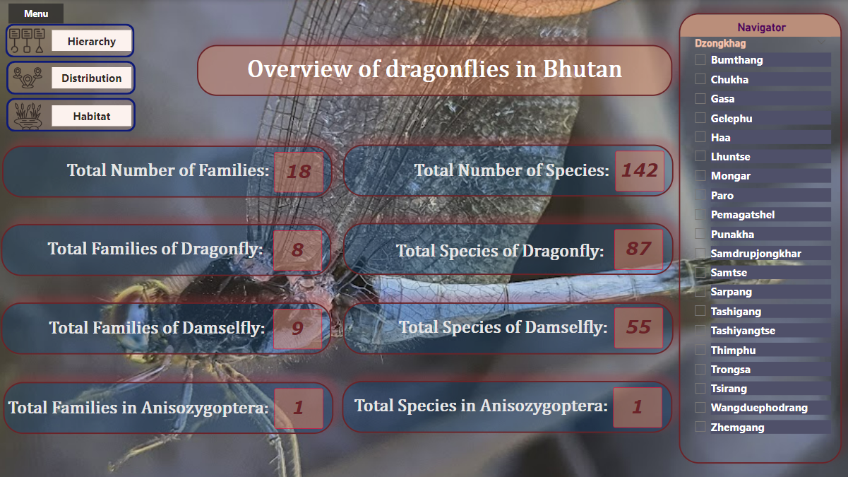
Home Page

Slide 3
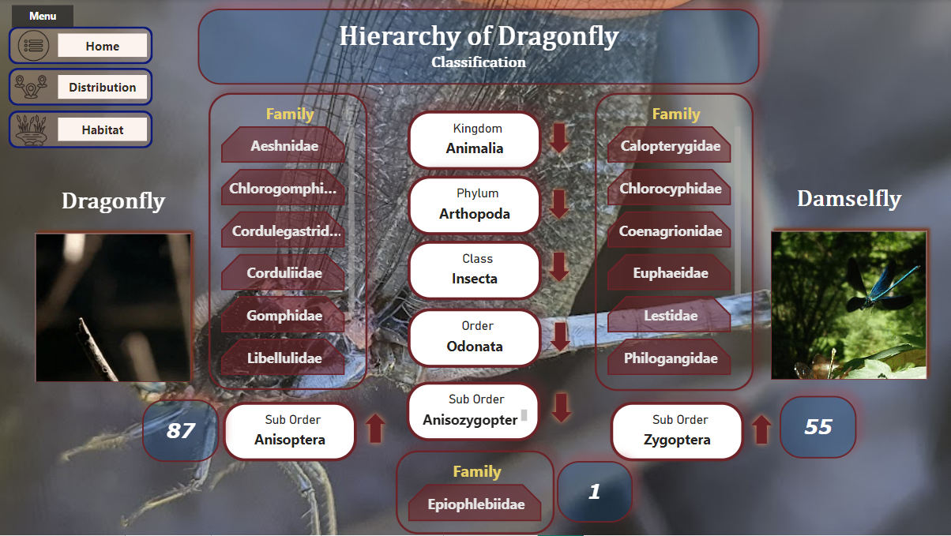
Hierarchy Page

Slide 4
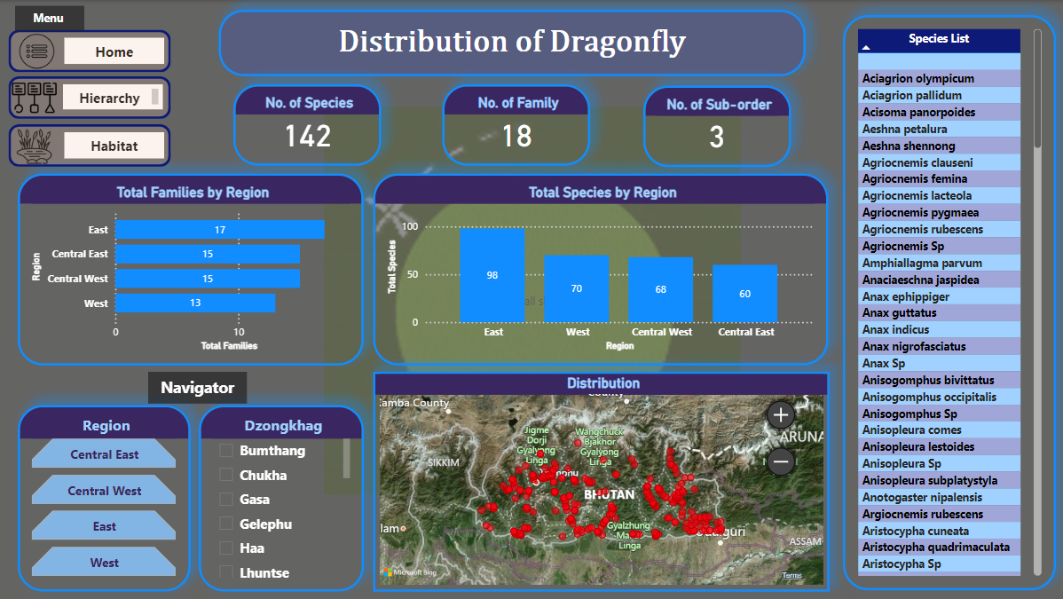
Distribution Page

Slide 5
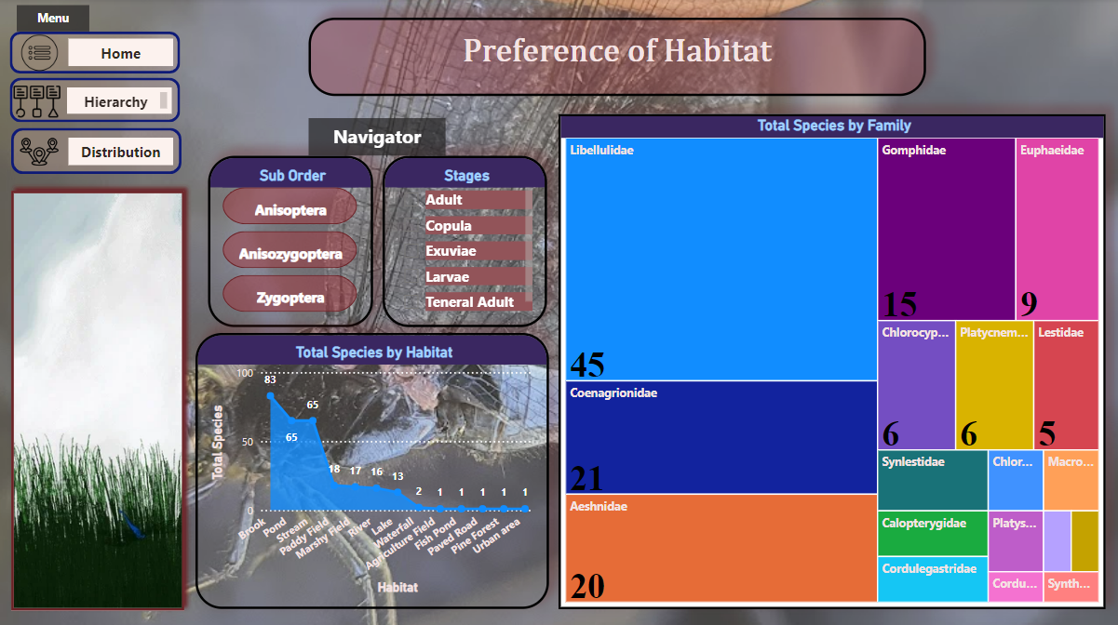
Habitat Page

Slide 6
Thank you
“I welcome you all for any questions”

